Slide 1

Market-Mediated Nutritional Transitions
In Low- and Middle-Income Countries
Christopher B. Barrett
Cornell University
Annual Bank Conference on Development Economics
Washington, DC
July 25, 2025

Slide 2
Structural and Markets Transformation
Structural transformation is an empirical regularity of economic development, characterized by rising agricultural productivity and output, rural to urban migration, intersectoral labor migration (including within agrifood value chains), and dietary transitions. (For more, see any of many Timmer writings)
Structural transformation is cause/consequence of markets development:
improved physical – e.g., communications and transport – and institutional– e.g., product standards, legal systems – infrastructure that reduce search and transactions costs.
enhanced spatial and intertemporal market integration that drives price and wage convergence over time, space and sectors.
How does markets development impact nutrition?
S

Slide 3
Market-mediated nutritional impacts
Markets development affects key drivers of consumer dietary choice and thus nutritional outcomes via any/all of multiple channels:
incomes
prices
product variety and composition
risk management
[For more, see Barrett et al. (JEL 2022), Masters et al. (HAE 2022)]

Slide 4
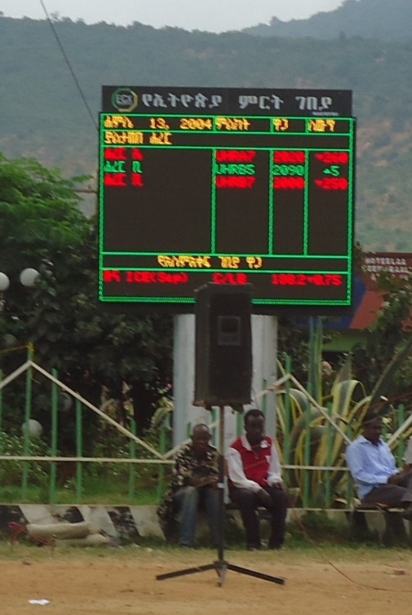
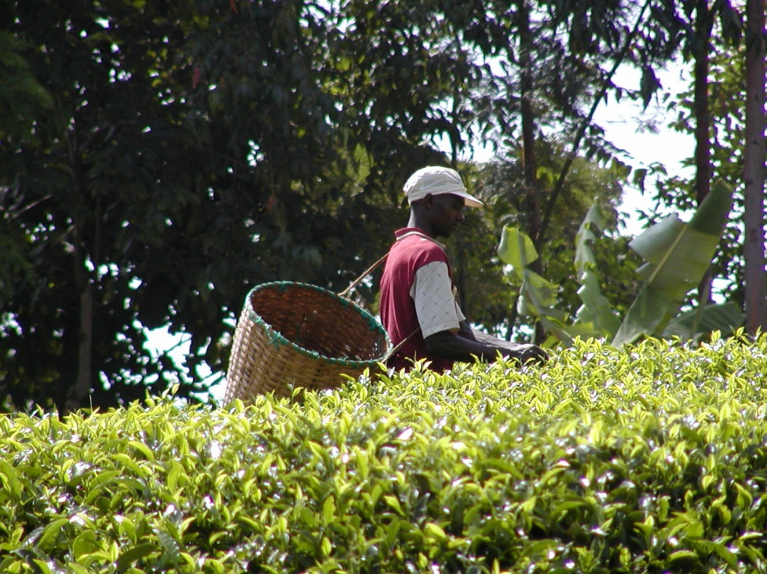
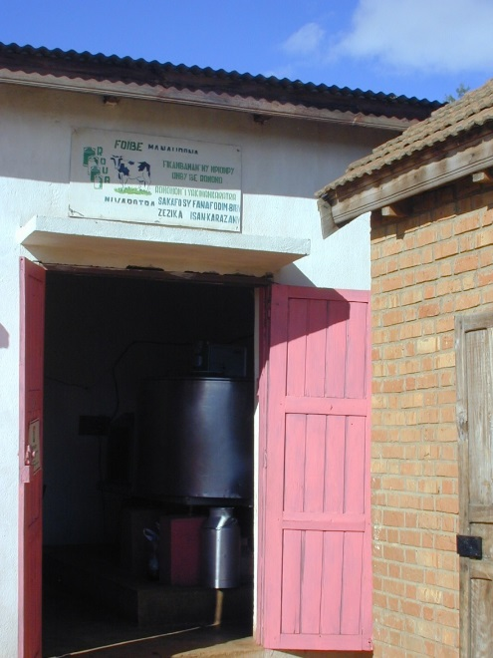
Income channel 1
Higher incomes better nutrition
Income effects via increased value of farm output
The main cause of food insecurity is poverty. Most of the poor are rural. Ag market development generates income for net seller farmers and farm workers. Need timely, affordable access to key inputs (e.g., seed, fertilizer) and a reliable outlet for evacuating surpluses w/o prices crashing.

Slide 5
Product diversification channel
Consumers value variety (Bennett’s Law)
Rising incomes and specialization in production drive even farm households to turn to markets to source food for home consumption. Greater diversity typically means improved dietary diversity, higher shares of animal-source foods, fruits, nuts, vegetables …. and prepared/processed foods.
Table A13. Share of food expenditures auto-consumed by farming households
Notes: Sample includes households from VHLSS 1992-2016.
Liu et al. Food Policy (2020)

Slide 6
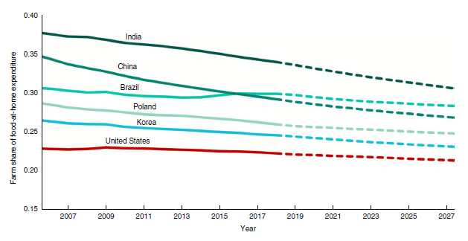
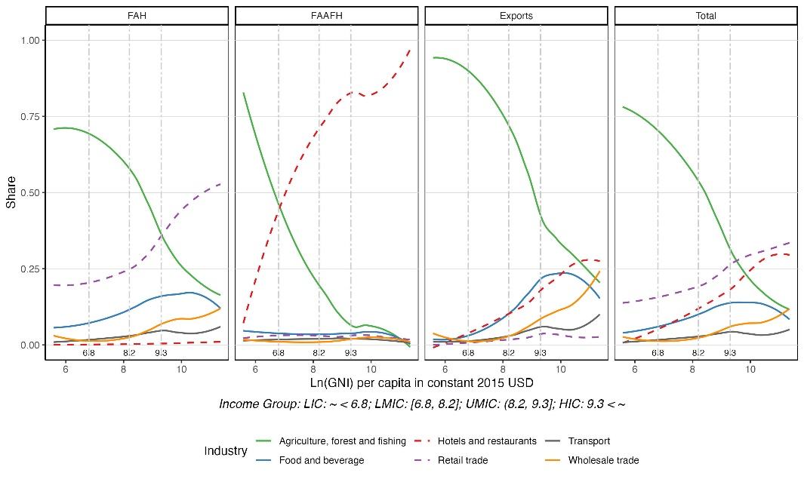
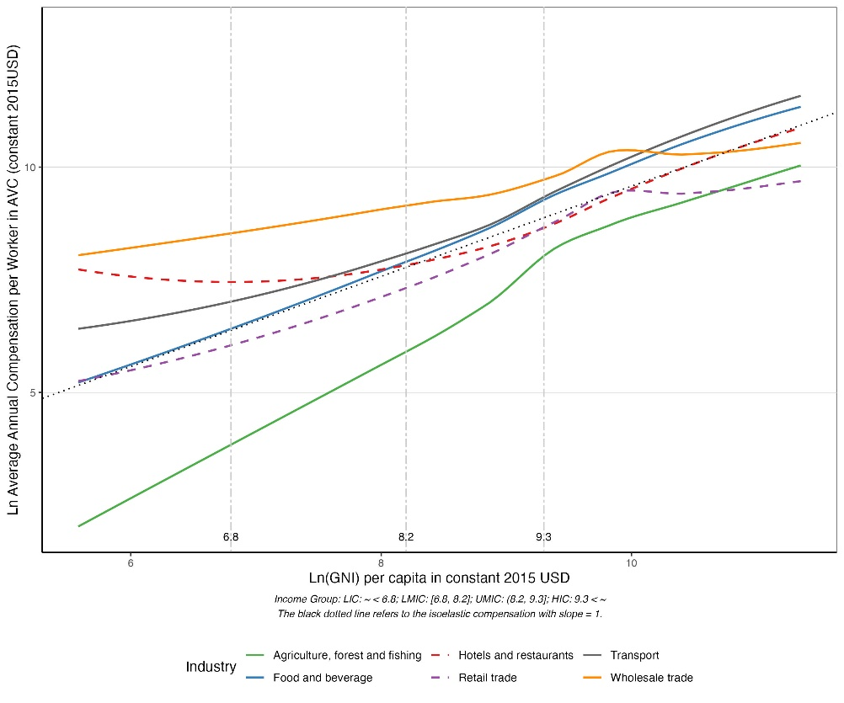
Income channel 2
Demand for variety and convenience boosts demand for post-harvest value addition. This yields income effects via occupational transitions.
As incomes rise, food value addition moves post-farmgate (globally >70%). Thus AVC employment/earnings shift post-farmgate to safer, better-paying jobs. Combined with reduced disease exposure, nutrition typically improves.
Yi et al., (Nature Food 2021)
Yi et al., (Nature Food 2025)

Slide 7
Real food price channel
Lower prices increased intake improved nutrition (to a point)
Productivity growth plus income and price inelastic demand generates big consumer surplus gains through lower food prices.
Price
Demand
New Supply
Original Supply
Given price inelastic demand, most gains accrue to consumers via reduced food prices.
(Cochrane 1958; Evenson and Gollin Science 2003)
Consumer
Surplus
P ^{old}
Old Producer
Surplus
New Consumer
Surplus
P ^{new}
New Producer
Surplus
Quantity
Quantity

Slide 8
Relative food price channel
Lower relative prices consumer substitution nutrition impacts?
Inter-product differences in productivity growth and income/price elasticities induce product bias in consumption expansion path due to income and substitution effects. (various Pingali papers)
Partly this arises due to differential R&D intensity: more on staple cereals, tubers and livestock than on fruits, legumes, nuts and vegetables. (Sekhri & Shastry AEJ:AE 2024)
And partly due to higher costs of processing/storage/transport for perishables.
Habit formation/cultural cuisine adaptation reinforce these effects. (Atkin AER 2013)

Slide 9
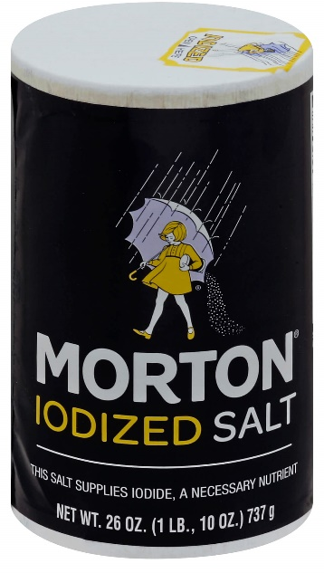

Product quality/composition channel
Rising incomes boost demand for product composition/quality
improved nutrition (to a point)
Post-harvest processing can improve or degrade foods:
Industrial fortification clearly good (salt iodization; iron, zinc and B vitamins in flour; folic acid in vegetable oil).
RUTFs literally life savers.
But most reformulation is for preservation and sensory appeal: add sugars, salt, saturated fats, synthetic chemical additives … with adverse nutritional/health impacts.
Need enforceable product standards and market regulation, especially for food safety.

Slide 10
Public contracting channel
Public procurement as a tool for shifting processes
Governments and multilaterals (e.g., WFP) are major buyers, for schools, prisons, hospitals, feeding programs, etc. Public procurement that uses “true cost of food” principles can create big incentives for firms to use production/processing methods that improve food quality. Heavily under-used; most procurement uses ‘lowest qualified bidder’ rules.
But it is easier to make progress on economic multipliers, environmental spillovers than on health impacts.

Slide 11

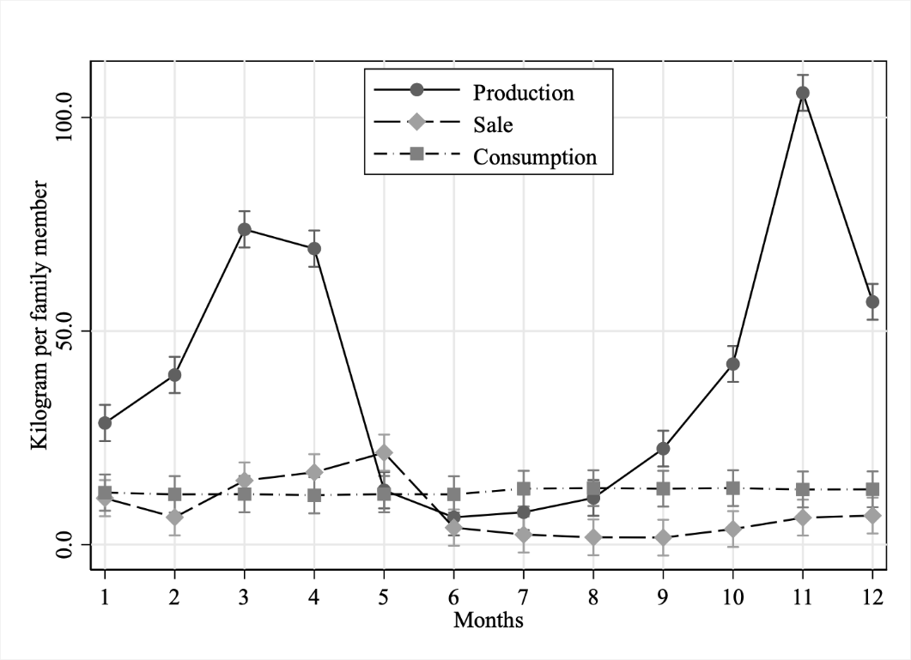
Risk transfer channel
Risk management
Risk management requires smoothing shocks through intertemporal (credit/savings) or state-based (insurance) transfers.
Commodity markets often develop sooner than – and can partly substitute for – financial markets. Better spatiotemporal arbitrage improves risk management options.
Trade enhances panseasonal access to perishables and management of weather shocks.
Market dev’t facilitates nutritionally important consumption smoothing (Negi & Barrett 2025 wp) and reduces urban bias in food price risk (Barrett JDS 1996).
Seasonality in staple cereal production, sale, consumption
(India, ICRISAT VDSA villages )

Slide 12
Summary
Markets development affects LMIC nutritional transitions
Happens via multiple income, price, product composition/quality and risk transfer channels
Lots of scope for policy-relevant research as too little attention is paid to post-farmgate market actors, their incentives, and how they influence consumer dietary choices.

Slide 13
Thank you
Thank you for your time and interest!
Follow-up questions/comments?
Email me : cbb2@cornell.edu

